Slide 1


Decoding Football's Winning Formula
Group Members
Gopi Nath Kota --- GXK220018
Sahitya Kolipaka --- SXK230086
Neha Katla --- NXK230000
Shubham Pathare ---SXP230008
Akshay Subramanian Ramesh --- AXS230128

Slide 2
CONTENTS
PROJECT DESCRIPTION
DATA DESCRIPTION
LOGICAL DATA MODEL
CONCEPTUAL MODEL
PHYSICAL DATA MODEL
DATA LOADING
INSIGHTS
GRAPHS

Slide 3
Project Overview
Objective: Analyze football-related data to identify winning strategies for team building in the sport.
Dataset : Consists player performances, club details, game events, competitions, and player valuations provide a holistic view of football dynamics.
This project aims to analyze, interpret, and derive meaningful insights from the wealth of data available within the football dataset
Our focus includes exploring trends in club performance, evaluating player valuations, understanding game dynamics, and uncovering correlations among various football parameters.

Slide 4
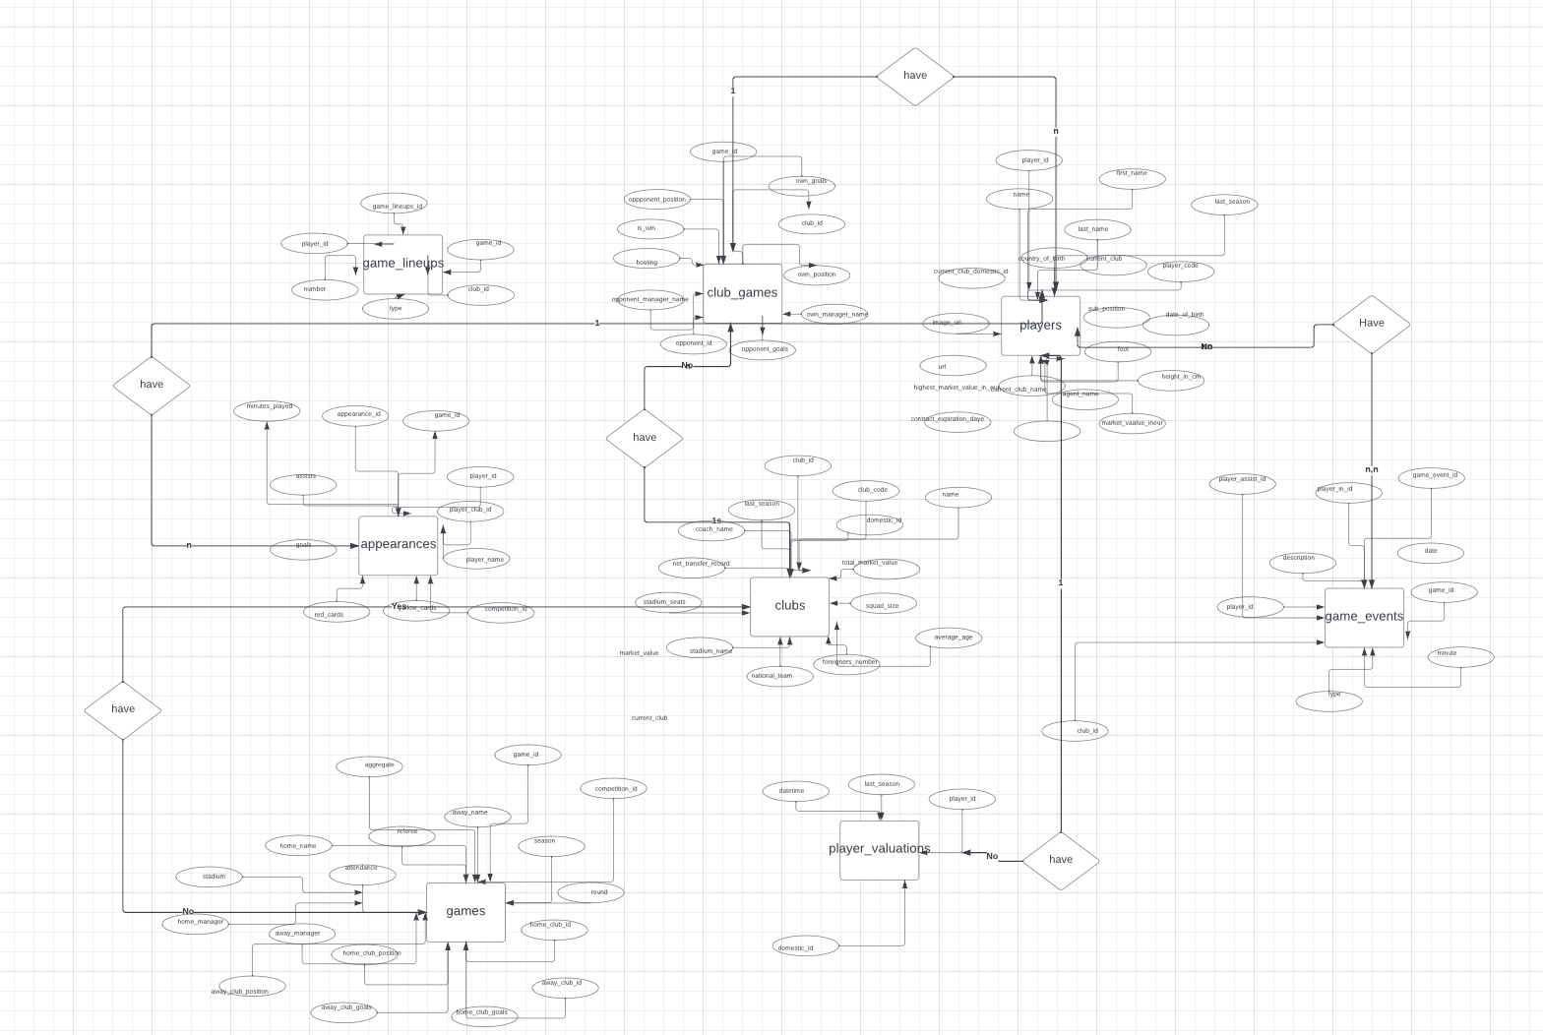
CONCEPTUAL DESIGN
Naveen Jindal School of Management (JSOM) The University of Texas of Dallas

Slide 5
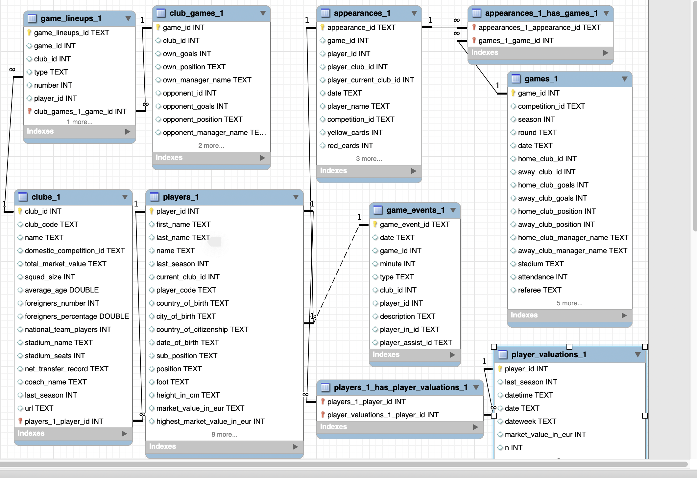
ER Diagram

Slide 6
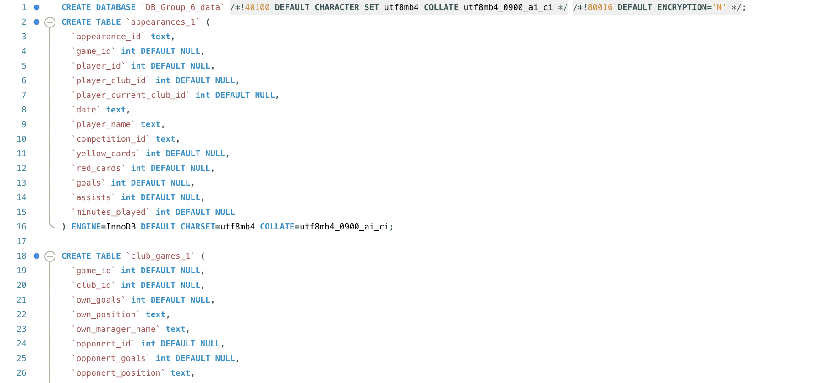
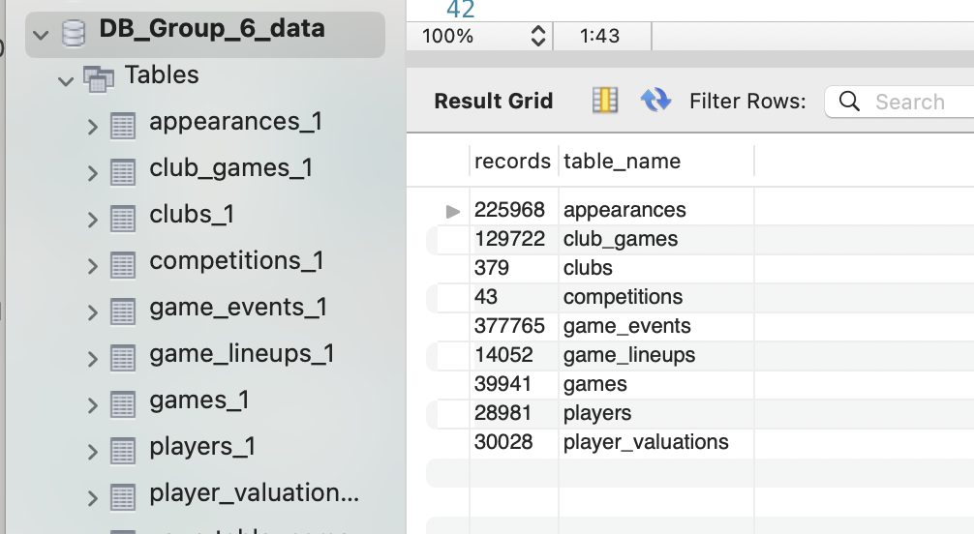
PHYSICAL DATA MODEL
Naveen Jindal School of Management (JSOM) The University of Texas of Dallas

Slide 7
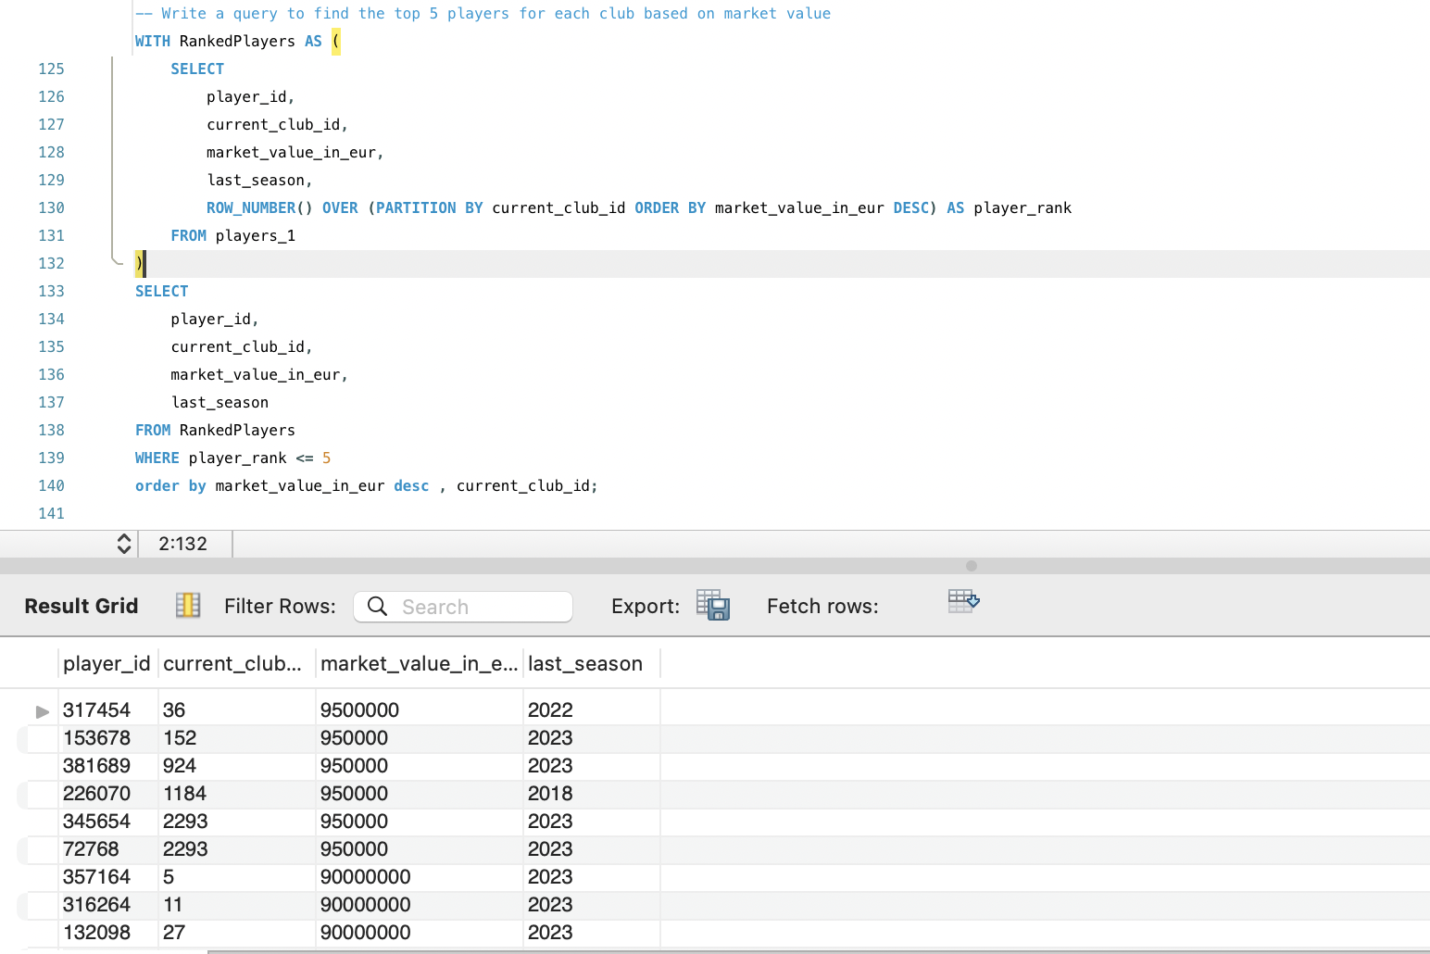
Top 5 Expensive players for each club
INSIGHTS

Slide 8
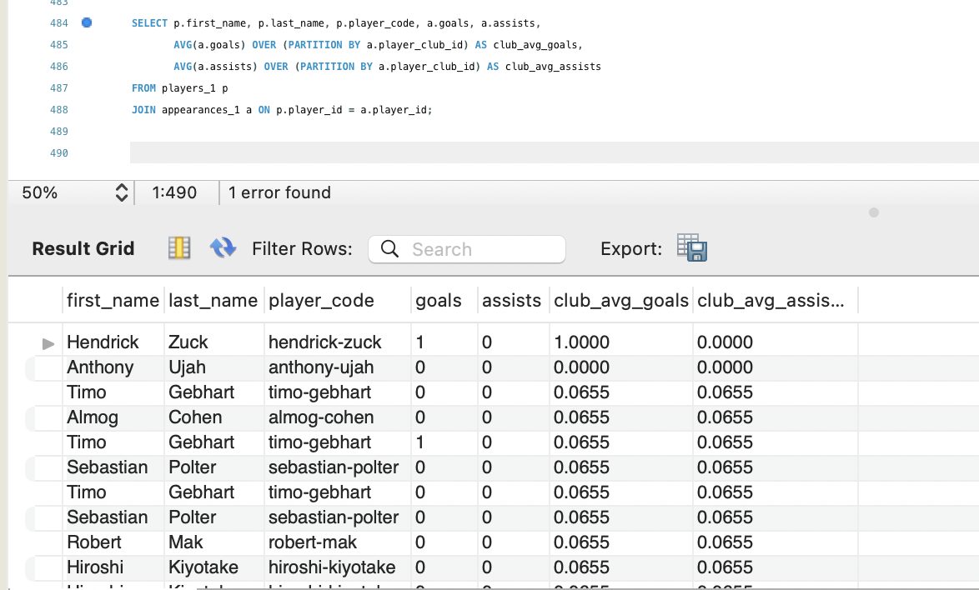
Player Performance Relative to Club Average
INSIGHTS
Naveen Jindal School of Management (JSOM) The University of Texas of Dallas

Slide 9
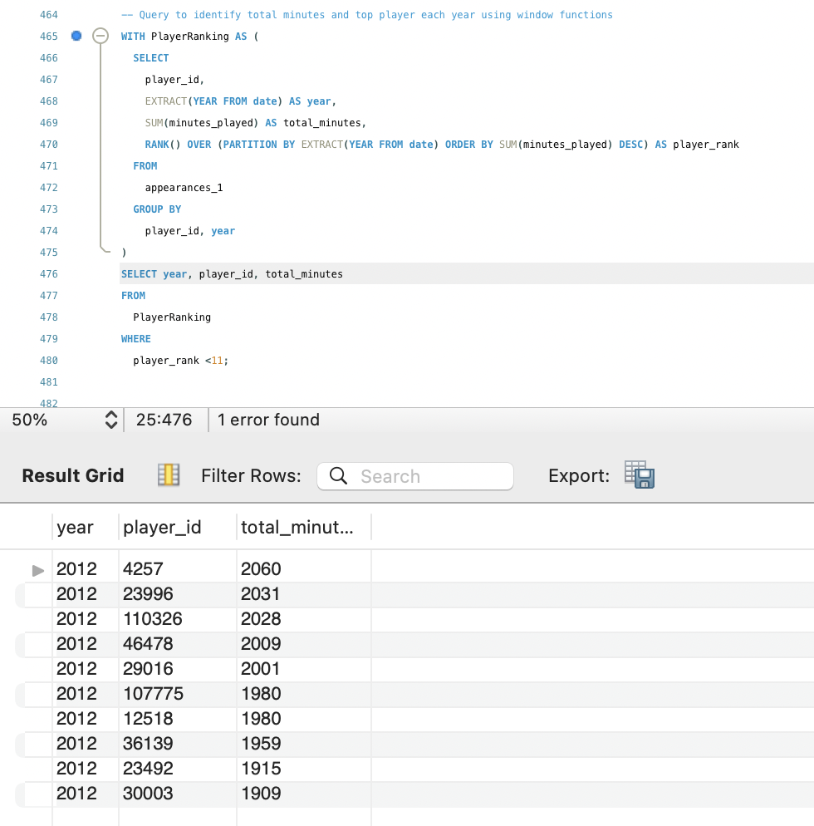
Top 10 players with respect to the minutes played
INSIGHTS
Naveen Jindal School of Management (JSOM) The University of Texas of Dallas

Slide 10
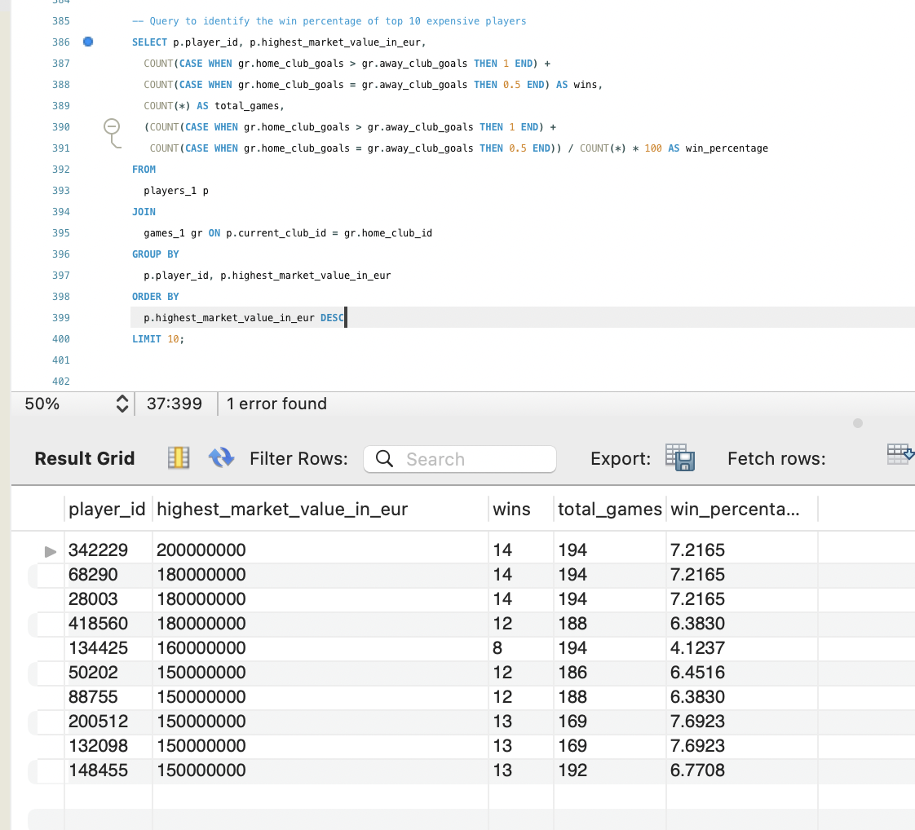
Players with High market value having low win percentage which says, more valuation doesn’t guaranty results
INSIGHTS
Naveen Jindal School of Management (JSOM) The University of Texas of Dallas

Slide 11
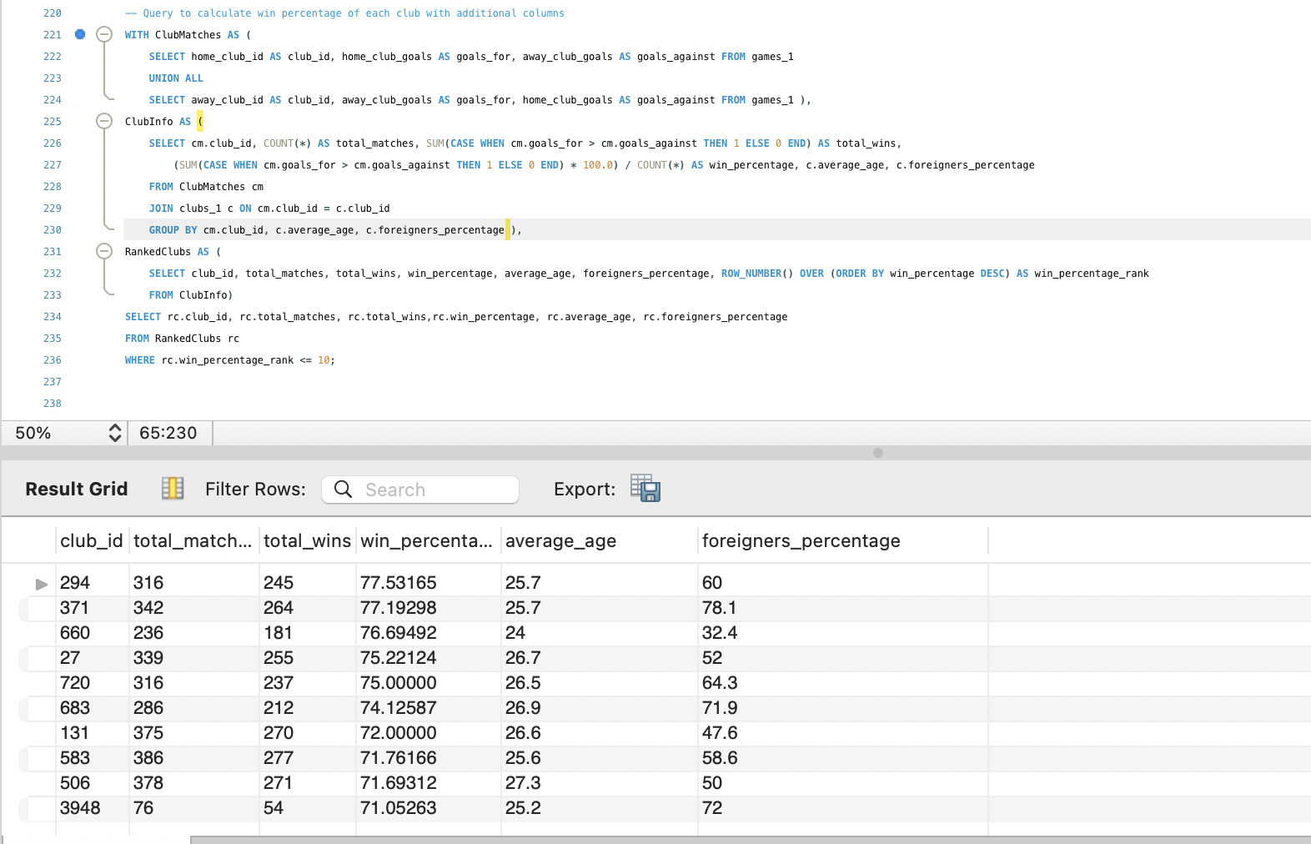
Average age among the most successful clubs is 26 while the minimum and max ages are 22 and 29 respectively. These clubs also have relatively high foreign players percentage.
INSIGHTS
Naveen Jindal School of Management (JSOM) The University of Texas of Dallas

Slide 12
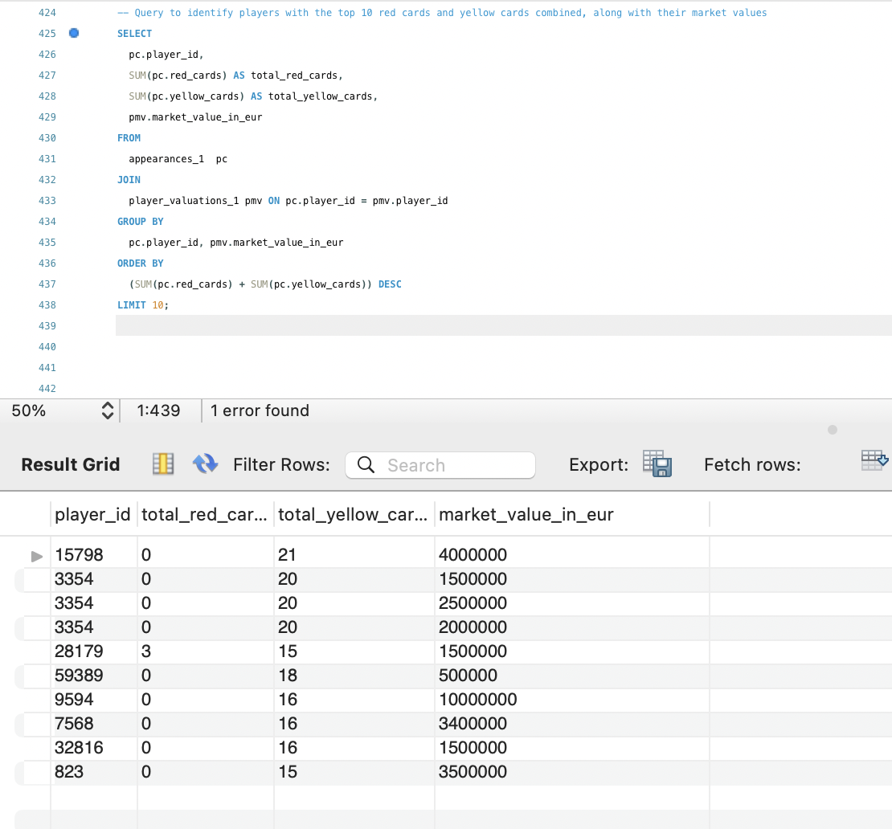
Players having highest yellow cards also having high market value in EUR
INSIGHTS
Naveen Jindal School of Management (JSOM) The University of Texas of Dallas

Slide 13
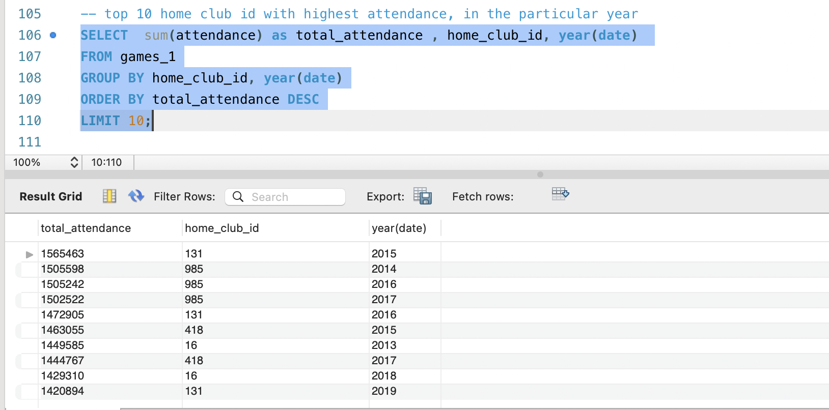
Which home club has highest attendance along with the calendar year?
INSIGHTS
Home clubs 131, 985 and 418 have highest attendances, which have potential of bringing more footfall business

Slide 14
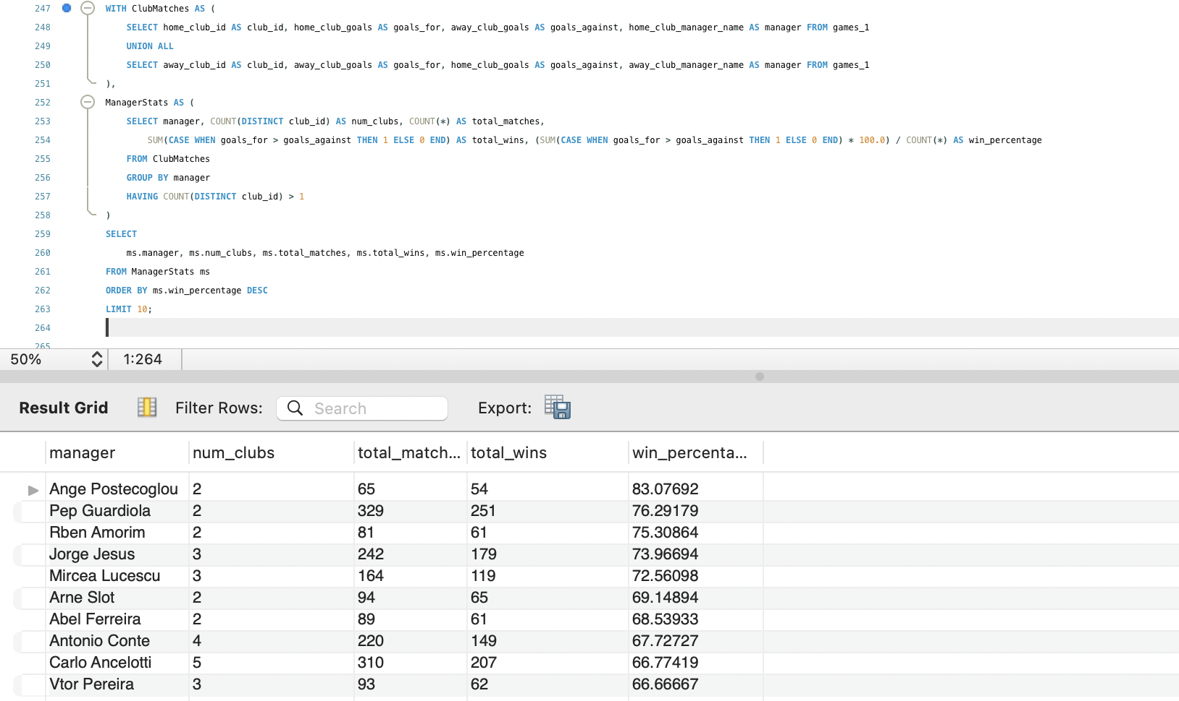
Identifying managers with highest win % and those who worked for multiple clubs, which can further help while recruiting new managers
INSIGHTS
Naveen Jindal School of Management (JSOM) The University of Texas of Dallas

Slide 15
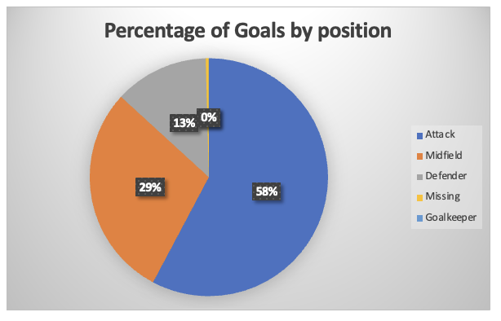
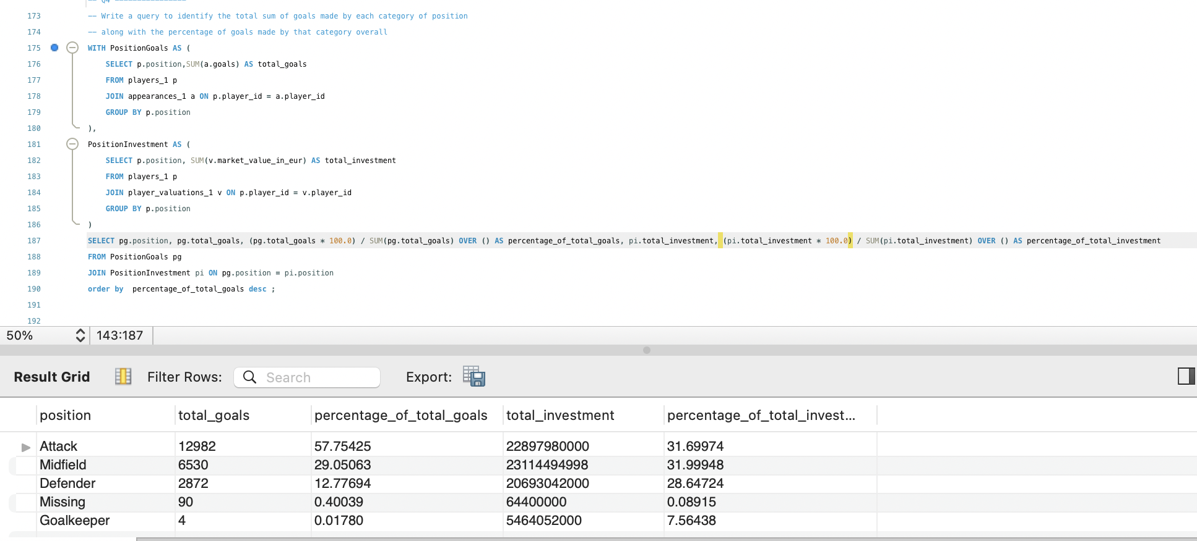
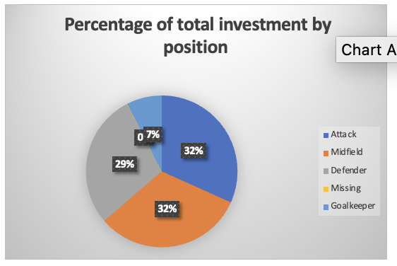
Impact of position on number of goals vs investment required for each position
GRAPH INSIGHTS
Naveen Jindal School of Management (JSOM) The University of Texas of Dallas

Slide 16
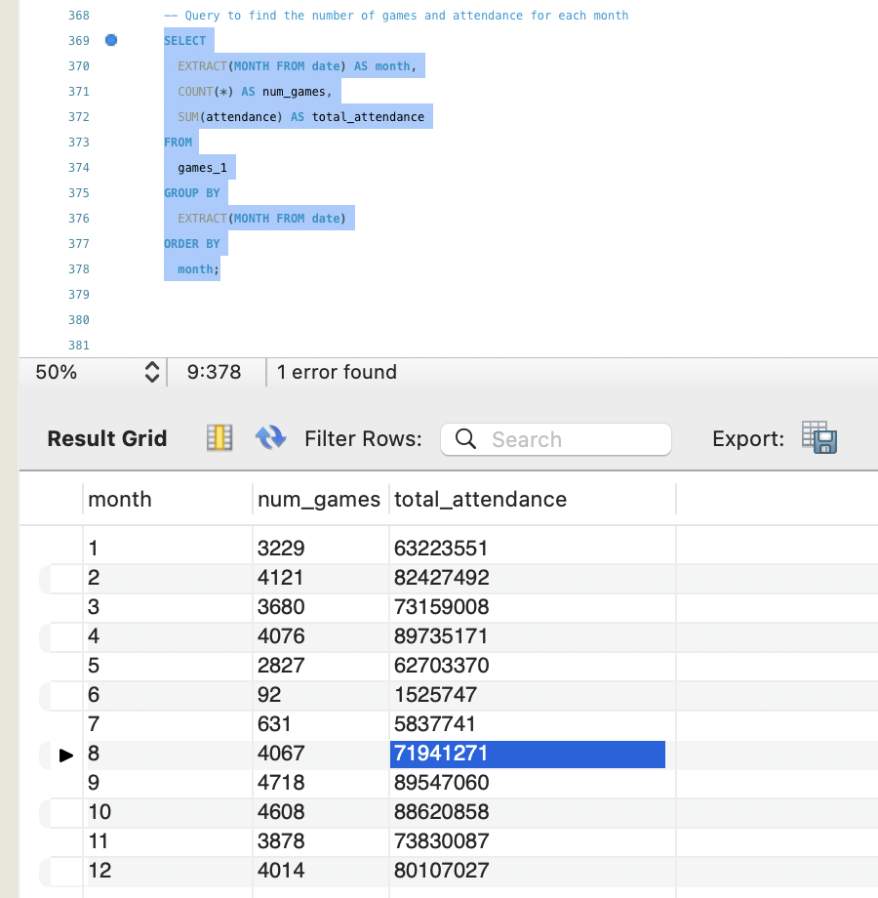
The attendance in the month of July is observed to be low.
GRAPH INSIGHTS
Naveen Jindal School of Management (JSOM) The University of Texas of Dallas

Slide 17
RECOMMENDATIONS
Home clubs 131, 985 and 418 have highest attendances, which have potential of bringing more footfall business
57% of goals are coming from attackers, while 31% are coming from Midfield. And their corresponding investment % is almost equal (31%). So Teams can utilize some amount of their investment into the defense and goal keepers so that, the respective positions also get strengthened.
The average age of top 10 clubs with highest win % is around 26, while the min and max average ages of the clubs are 22 and 29 respectively. Hence, we can conclude the players need to be young as well as experienced to fall into the 26 age bracket which is giving good results
Trade Managers with highest win %
Naveen Jindal School of Management (JSOM) The University of Texas of Dallas

Slide 18
THANK YOU

